Slide 1
Analysis Report (UDEMY COURSES DATA) – Divyansh Dubey
My analysis of the problems/insights based on my findings from the data.

Slide 2
Project Description
I am a Data Analyst working for the education tech company, Udemy. I have been asked by My manager, Head of Curriculum at Udemy, to present the data on course revenue, and i have been provided with data on courses from different topics to understand where opportunities to increase revenue may lie, and track the performance of courses.
Your manager has suggested encouraging Web Development courses to charge more, because she believes that these are the most popular courses. She needs to send a report to the CEO in the next three weeks on how they will increase their next quarter earnings.

Slide 3
Design
Tools used for analysis, visualisation and reporting:
Ms excel
I used google-spreadsheets for analysing data as it is easy to use and a handy tool for data analysis.
Tableau
Tableau is one of the most popular visualisation tools across the world because of its easy to use and handy interface to work on.
Ms PowerPoint
I used MS PowerPoint for reporting because of its extensive features list which we can use to present reports. It is really easy to use.

Slide 4
Design
Steps:
Read and worked on understanding the data.
Consolidate the relevant data.
Data cleaning
Removed duplicates
Removed blank cells
Removed/replaced inconsistent data
Used right/left function to create “date” column.
Used if function to create a “free beginner courses” column.
Used the VLOOKUP function to find and organise this information on a separate sheet.

Slide 5
Design
Steps:
Data visualisation
- Created the following Pivot Tables and Charts using excel and tableau:
Total number of subscribers for each subject (Pie Chart)
Average number of subscribers for each subject (Bar Chart)
Average cost per subject at each level (Bar Chart)
Average content duration for each subject (Bar Chart)
Average rating per subject for each level (Column Chart)

Slide 6
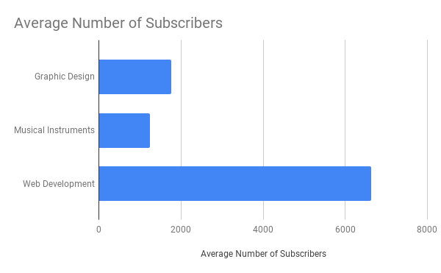
Findings and Insights
Web Development courses are most popular among offered courses
While Musical Instruments courses are least popular among subscribers.

Slide 7
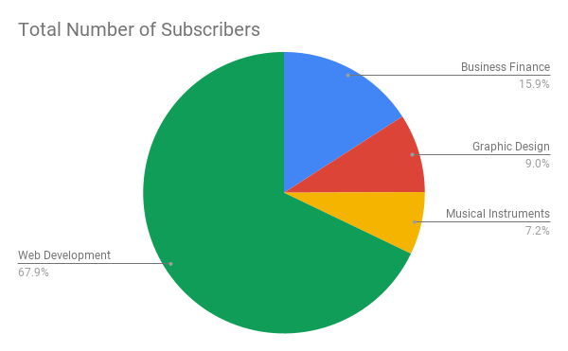
Findings and Insights
Graphic Design Courses are also not doing pretty well.
Business Finance courses have relatively very low subscribers as compared to web development courses.

Slide 8
Analysis: Reasons/causes behind Insights
Web Development courses are most subscribed courses because:
As coding is basically a computer based learning and using internet to learn these skills at just at arms length. Along with this, online discussion forums and google plays a huge part for making it a more interactive learning.
One can get best teachers to learn programming , right at home which is not an easy thing to get at remote areas of the world, where even having a proper school is a big deal.
Musical Instrument courses are least popular among masses because:
Students are not comfortable, learning to play musical instruments online.
Mentoring online is not a proper method to teach playing instruments. Students must not be able to learn properly online, they may need more in-person interaction with the mentors to properly learn playing instruments.

Slide 9
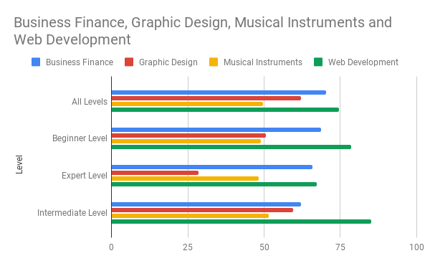
Analysis: Reasons/causes behind Insights
In the case of Business Finance courses, they have relatively very low subscriber base as compared to Web Dev Courses, but have the similar average prices to that of Web Development courses. This may be hampering their potential to increase their subscriber base significantly.

Slide 10
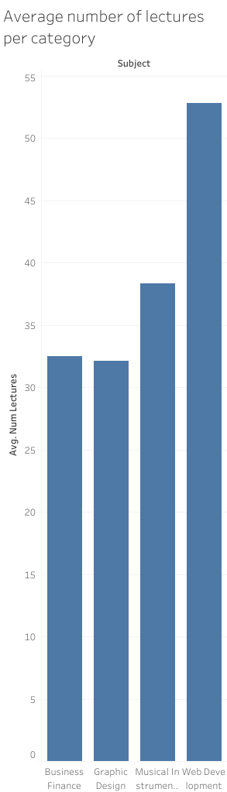
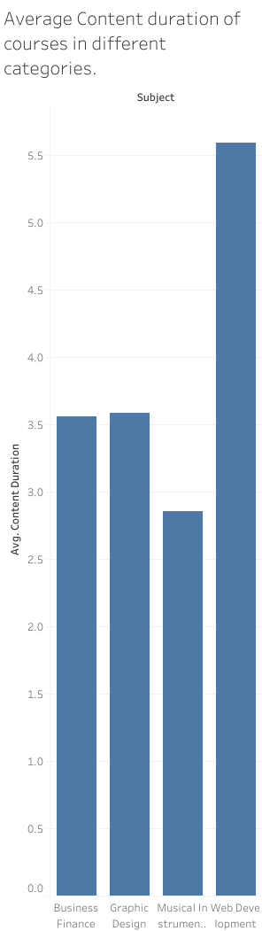
Analysis: Reasons/causes behind Insights
One of the factors behind Web Development courses doing better than other categories- is the thorough content of web dev courses while other courses lagging behind in that. This can be seen in following charts which shows the number of lectures per content and average content duration per category, respectively.

Slide 11
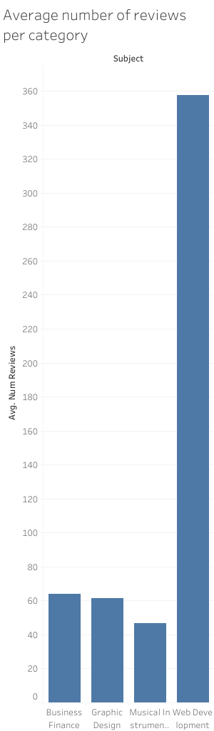
Analysis: Reasons/causes behind Insights
Web Development courses subscribers are proactive in using technology which is why these courses are doing really well. This can be explained by the fact that they are more proactive in reviewing content which can be seen in the chart showing average number of reviews per category.

Slide 12
Conclusion: My proposals for solutions
In the case of Web Development courses, We can increase the prices of the courses accordingly to take advantage of their popularity among subscribers/users.
In the case of Business Finance courses, they can also improve their subscriber base by lowering prices a little while improving the content of the courses making them more thorough.
Those category of courses which are not doing well, should work on course content making them thorough and more comprehensive.

